Slide 1




Module Name - Abstraction & Encapsulation
Class - Day 2
Topic Name- More about OOPS
EditEdit MasterMaster texttext stylesstyles

Slide 2
Time Allocation Summary
Element | Slide numbers | Maximum time allowed (min)
Today’s Agenda | 4 | 3
Spot Test | 5-6 | 5
Introduction to Static and Final Keyword | 7 | 2
Static Keyword | 8-13 | 10
Final Keyword | 14-17 | 10
Types of Attributes & Methods | 18 | 2
Abstraction: First Principle of OOPs | 19-24 | 12
Introduction to Access Modifiers | 25-26 | 8
Public Access Modifier | 27-29 | 8
Private Access Modifier | 30-36 | 10
Getter Methods | 37-42 | 15

Slide 3
Time Allocation Summary
Element | Slide numbers | Maximum time allowed (min)
Setter Methods | 43-46 | 10
Constructors vs Setter Methods | 47-53 | 10
Private Methods & Constructors | 54-55 | 5
Applications of Private Access Modifiers | 56-57 | 5
Summary | 58-60 | 5
Total Time |  | 120

Slide 4
Today’s Agenda
Use of static & final Keyword
Abstraction
Public & Private Access Modifier
Getter Methods
Setter Methods
Constructor vs Setter Methods
Private Methods & Constructors

Slide 5
Spot Test
How many classes are allowed to be made in a Java File?
What is an object?
How is object declared for a class? Which Operator is used? Give complete syntax.
Can multiple objects be created for a class?

Slide 6
Spot Test
What happens when a method is declared as final?
What is the difference between parameterized and default constructors?

Slide 7

Introduction to static & final Keyword
Time to learn about two important keywords while programming in Java - static and final.
They are very helpful in making your program
more safe and memory efficient.

Slide 8

Static Keyword
Static Variable
Variables declared as static are known as static variables. Static variable is used while referring to the common property of all the objects of the class.
The static variable is allocated memory only once,
at the time of loading a class.

Slide 9

Static Keyword
For example, university name for students in the Student class for an information management system
of a university.
Static variables are useful if you need to
share the same set of information across all objects of a class, such as the University name in our example.

Slide 10

Static Keyword
Static Methods
Methods declared as static are known as
static methods. A static method belongs
to the class, rather than object of a class.

Slide 11

Static Keyword
It can be called without creating the object of the class, using ClassName.staticMethod( ) notation.
Static methods cannot access non-static
variables, or call non-static methods. But
static methods can access any static
variable and change its value.

Slide 12
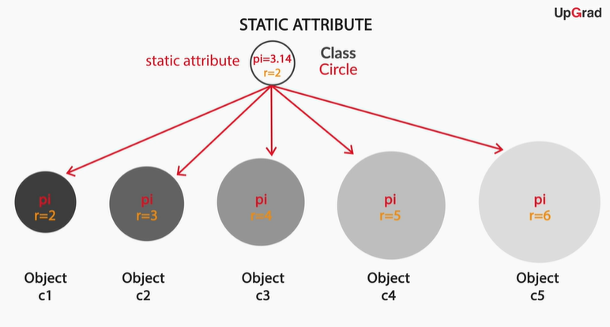
Static Keyword
Variable pi declared as a static variable as it’s value has to be same for all the objects

Slide 13

Static Keyword
Note: main method is declared as static. It will be unique for any Java File. One can have other methods also named as main but they must not be declared as with same function signature.

Slide 14

Final Keyword
Let’s now learn about the final keyword.
The final keyword is used to restrict the user.
If any method is declared as final, you cannot
override that particular method.

Slide 15

Final Keyword
Final variables
If any variable is declared as final, you cannot
change the value of that variable. It can be
assigned any value only once, and then it
remains constant throughout the program.
Final variables are useful if you have global constants in your programs that should never be changed.

Slide 16
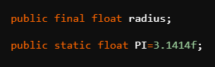
Final Keyword
This is how radius variable is declared as final. Its value could have been initiated at this step only.
Like here, it is assigned no value, so
it has the default value and if there is any attempt to change its value in any other step then the code will show an error.
Note: A variable can be declared as a static final variable also. It will be a static variable whose value can’t be changed once initialized.

Slide 17

Final Keyword
Final methods
If you declare any method as final, you cannot override that.
Notes:
Meaning of overriding to be explained later

Slide 18
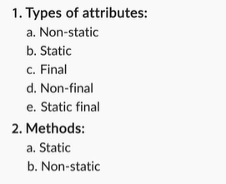
Types of Attributes & Methods
Types of Attributes & Methods

Slide 19

Abstraction: First Principle of OOPs
You have learnt various topics such as classes and objects, default and parameterized constructors, and static and final keywords.
All of these concepts fall under the umbrella
of the first principle of OOP — Abstraction.

Slide 20

Abstraction: First Principle of OOPs
What is Abstraction?
Abstraction is a principle based on hiding the
details of implementations of classes, and
access only certain features/functionalities
given to the users/other parts of the program.
This is done by writing your program using the framework of classes and objects.

Slide 21

Abstraction: First Principle of OOPs
Advantages of abstraction:
Abstraction allows you to use the functionality (behaviour) of the objects from other parts of the code
without showing the internal
implementation of that functionality
(methods).
Rights to change the implementation of a class can be given only to a certain set of users.

Slide 22

Abstraction: First Principle of OOPs
Others cannot go and arbitrarily change
anything within the class, apart from using the
behaviors defined by that class by creating
and using its objects.

Slide 23
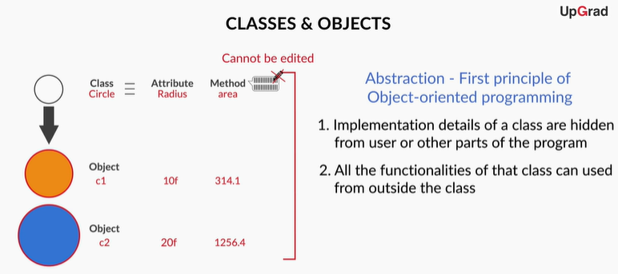
Abstraction: First Principle of OOPs

Slide 24
Abstraction: First Principle of OOPs
GOOD DESIGN PRINCIPLES FOR CLASSES & OBJECTS:
1. Identify the problem and start thinking about it using computational thinking framework
2. Start thinking about what can be modelled as classes, their methods and their objects.
3. Identify which method would belong to which particular class.

Slide 25

Introduction to Access Modifiers
You must have encountered a term named public in all our codes. What does this represent? What purpose does it solve?
Is it another keyword in Java?
Well, the answers to all these questions can be
given when you’ll have knowledge about concept
of Access Modifiers.

Slide 26
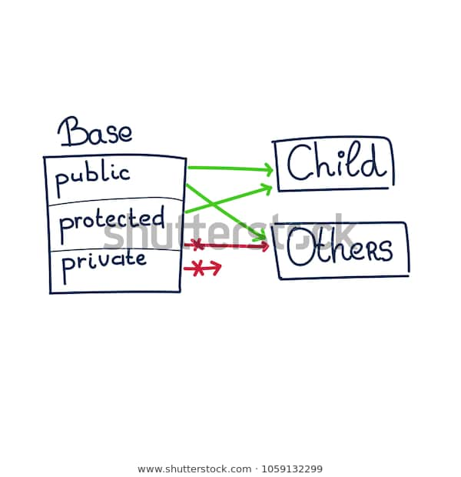
Introduction to Access Modifiers
What are Access Modifiers?
Access modifiers are used to restrict the
accessibility of methods or variables of a
class. There are four types of access
modifiers—public, private, protected, and
default—in Java.

Slide 27

Public Access Modifier
Public
When you declare a variable or a method as public in a class, it signifies that it can be
accessed throughout the class.
You can access these variables and
methods from other classes as well.

Slide 28
Public Access Modifier
When a method of a class is declared as public, it can be accessed by creating an object of its class in other classes.
If it is a static method, then you can directly access it using className.method() without creating an instance.
This creates potential issues because other classes can now access these public variables and methods and write code that depends on them.

Slide 29
Public Access Modifier
This will reduce your flexibility to change the implementation of these public variables and methods at a later point.
This is because it will affect other classes that depends on these public variables and methods.

Slide 30

Private Access Modifier
Private
When you declare a variable as private in a class, it signifies that it can be accessed throughout
the class but not outside of it.
You can’t access it from another
class.

Slide 31

Private Access Modifier
When a method is declared private, it cannot be accessed by creating an object outside the
class.
It is restricted only to the class
that contains it.
Notes:
protected and default access modifiers to be taught later.

Slide 32
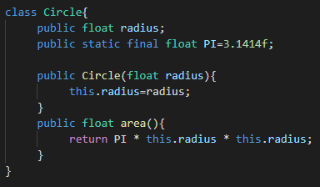
Private Access Modifier
Suppose there is any circle class which has an area method inside it taking radius as input.
Notes:
protected and default access modifiers to be taught later.

Slide 33
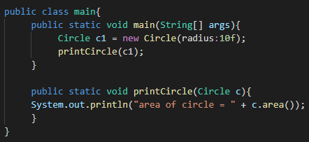
Private Access Modifier
Now we create an object for circle class in our main class and specify the value of radius in it. Main class also contains a printCircle method.
Initially area will be computed by printCircle method using this specified value of radius.
Notes:
protected and default access modifiers to be taught later.

Slide 34

Private Access Modifier
Here the program will work smoothly and return us the correct area for our specified radius but if by mistake we specify different radius inside printCircle method then that radius will override our specified radius.
The area will be computed using this radius now which we don’t want.
Notes:
protected and default access modifiers to be taught later.

Slide 35
Private Access Modifier
This is happening because the radius attribute in our Circle class is public.
Radius is public
Notes:
protected and default access modifiers to be taught later.

Slide 36
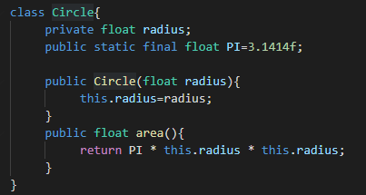
Private Access Modifier
Hence if we change public to private than nothing can override our specified radius as it can’t be changed outside Circle class. Even if we write other radius in printCircle as before, our radius will still not be changed.
Notes:
protected and default access modifiers to be taught later.

Slide 37

Getter Methods
Although, private modifier saves a variable or method implementation from getting altered but a disadvantage with the private modifier is that it does not even allow to read or print the value of the variable.
So, how to solve this problem?
This is done using getter method.

Slide 38

Getter Methods
Getter methods
Getter methods are used to access private
variables from outside the class in which
they are declared.

Slide 39

Getter Methods
class Demo {
private int var = 5; //assigning a value to the private int variable
public int getVar() {
return var;
}
}
After this code, you can access the value assigned to this variable from outside the class.

Slide 40

Getter Methods
You can do this by calling the getVar( ) method from outside the class in the following manner:
public static void main(String[] args) {
Demo d = new Demo();
d.getVar(); // calling getVar method to access its value
}

Slide 41
Getter Methods
In this example, getVar is the getter method. Now, var was a private variable whose value can’t be accessed directly in the main method. But, getVar can access var as it is in the same class.
Also, getVar is a public method. So, it can be called in the main method which is in the different class. So, eventually var was accessed in a different class indirectly.

Slide 42
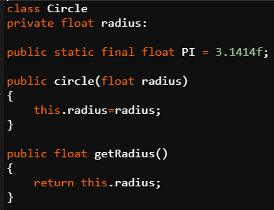
Getter Methods
Getter method can be created for any attribute whose value has to be accessed for reading or printing.
Getter Method for radius Attribute

Slide 43

Setter Methods
After getter methods, now it’s time to get introduced to another similar type of method known as the setter method.
Setter methods are used to set a new value to
private variables, or modify their values from
outside the class in which they are declared.

Slide 44
Setter Methods
class Demo {
private int var; // just declaring a private int variable
public void setVar(int var) {
this.var = var;
}
}
After this code, you can assign a new value to this variable from outside the class by calling the setVar( ) method from outside the class.

Slide 45
Setter Methods
public class ClassesAndObjects {
public static void main(String[] args) {
Demo d = new Demo();
d.setVar(5); // calling setVar method to modify its value
}
}

Slide 46

Setter Methods
The setter method uses the same approach as getter only.
The only difference is that inside its
method definition, the setter method
sets the value of attribute using this
keyword instead of just returning the
value.

Slide 47

Constructors vs Setter Methods
You know that constructors are also used for the purpose of initialising the instance variables while creating a new object.
So, what would be the major difference
between a setter method and a
constructor?

Slide 48
Constructors vs Setter Methods
Constructor vs Setter methods
Constructors are automatically called as soon as the object is being created, whereas setter methods can be called after the object is created, for example, when you want to set/modify the value of any instance variable.
Name of a constructor is always the same as the name of the class.

Slide 49
Constructors vs Setter Methods
No return type (void, int, String, etc) is mentioned in case of constructors.
Different constraints for the values of variables can be added to the setter methods.
You can also call the setter method from the constructor, if you want to place constraints on the values of the instance variables of the class while creating a new object. Next slide contains the code for it.

Slide 50
Constructors vs Setter Methods
class Demo {
private int var; // just declaring a private int variable
public Demo(int var) { // declaring parameterized setter method
setVar(var);
}

Slide 51
Constructors vs Setter Methods
Continued….
public void setVar(int var) { // declaring setter method
this.var = var;
if (this.var < 0){ // adding constraint
this.var = 0;
}
}
}

Slide 52

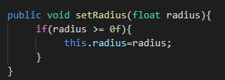
Constructors vs Setter Methods
Constructor vs Setter: Example
Constructor----->
Setter------------>
How can we modify constructor
To initialize the radius using
setter method?

Slide 53

Constructors vs Setter Methods
Instead of directly assigning a value to radius using this.radius we can call setter method inside constructor as follows
By doing this we have ensured that our radius is always a non negative variable. If we don’t use setter method than during object creation someone can specify a negative radius too.

Slide 54

Private Methods & Constructors
You can also declare the methods or constructors as private.
private methods: If you declare a method of
any class as private, you can call that method
within that class only and there is no way to
call it from outside that class.
private constructors: If you make any class constructor private, you cannot create the instance of that class from outside the class.

Slide 55
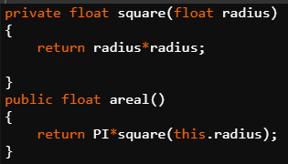
Private Methods & Constructors
square method() is used by the area
method() as they are in the same
Class.
However, it can’t be used outside
its own class.
Private Method: Example

Slide 56
Applications of Private Access Modifier
Applications of Private Access Modifier
Declaring attributes as private
Getter Method
Setters Method
Declaring method as private

Slide 57
Applications of Private Access Modifier
Declaring constructor as private
Not possible to make objects of that class in this case
Can be used in specialised cases

Slide 58
Summary
Static variable is used while referring to the common property of all the objects of the class. The final keyword is used to restrict the user. If any method is declared as final, you cannot override that particular method.
Abstraction is a principle based on hiding the details of implementations of classes, and access only certain features/functionalities given to the users/other parts of the program.

Slide 59
Summary
Access modifiers are used to restrict the accessibility of methods or variables of a class. There are four types of access modifiers—public, private, protected, and default—in Java.
Public keyword: When you declare a variable or a method as public in a class, it signifies that it can be accessed throughout the class and outside it.
Private keyword: When you declare a variable as private in a class, it signifies that it can be accessed throughout the class but not outside of it.
Notes:
Student class Demonstration example to be explained for more deep illustration

Slide 60
Summary
Getter methods are used to access private variables from outside the class in which they are declared.
Setter methods are used to set a new value to private variables, or modify their values from outside the class in which they are declared.
Notes:
Student class Demonstration example to be explained for more deep illustration

Slide 61

#LifeKoKaroLift
Thank you!

